Slide 1
Nuts & Bones: Rumble in the graveyard!
Kevin Lopez
Jimmy Tran

Slide 2
Background
Gravekeeper creates a robot to do his job for him.
Meanwhile, the monsters in the graveyard have come to life to get revenge.
Alex the robot must put down the dead for good.

Slide 3
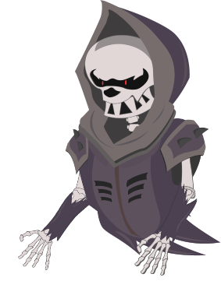
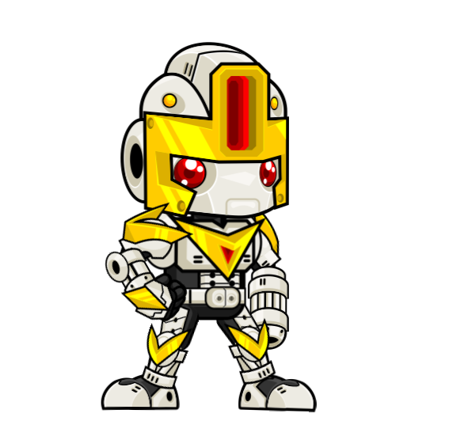
Main Character
Level 1 Enemies

Slide 4
Level 1
Tutorial style Level where player learns the basics of the game on their own.
Shows different pathways that ultimately lead to the final platform
Boss is designed to be slightly difficult, but easy enough to be a level 1 boss

Slide 5
How to play
Arrow Keys:
<- Left, -> Right
Up Arrow: Jump
Down Arrow: Slide
Q: Shoot Bullets (Ranged)
W: Laser Sword (Melee)

Slide 6
Mechanics
Jump Force
Gravity
Health
Movement Speed
Attack power
Attack Speed

